Slide 1

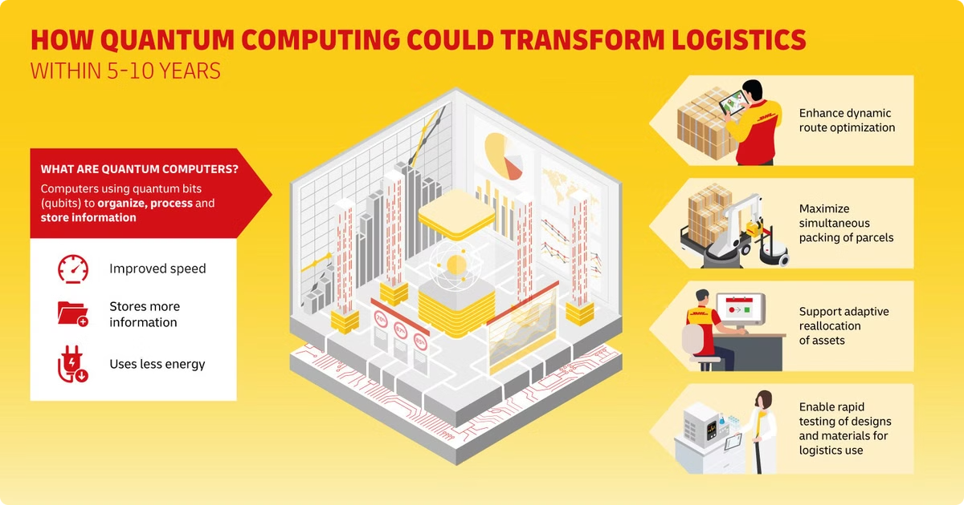

Quantum Computing and the Future of Logistics
Quantum computing holds immense potential to revolutionize the logistics industry by providing unparalleled optimization capabilities, enhanced decision-making, and unprecedented insights into complex supply chain challenges
22071A6744
Sai charan perala
.

Slide 2

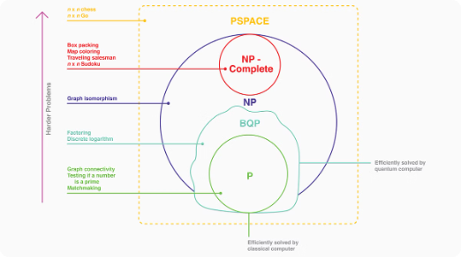
Understanding the Limitations of Classical Computing in Logistics
1
Complexity Limitations
2
Speed Constraints
3
Scalability Issues
Classical computers struggle to efficiently solve complex logistics optimization problems with massive data sets and numerous variables.
Traditional algorithms are often too slow to keep pace with the real-time demands of dynamic supply chain operations.
As logistics networks grow, classical computing power becomes increasingly strained, hindering effective decision-making and operations.

Slide 3


Quantum Algorithms for Optimization Problems
1
Quantum Annealing
Leveraging quantum mechanical phenomena to find optimal solutions for complex logistics optimization problems.
2
Quantum Simulations
Modeling and simulating logistical systems at a quantum level to uncover novel insights and strategies.
3
Quantum Machine Learning
Harnessing the power of quantum computing to enhance predictive analytics and decision-making in logistics.

Slide 4
Quantum Annealing for Vehicle Routing Optimization
Improved Efficiency
Real-Time Adaptability
Enhanced Decision-Making
Quantum annealing can rapidly find optimal routes, reducing transportation costs and emissions.
Quantum algorithms can quickly re-optimize routes in response to dynamic changes, such as traffic or weather conditions.
Quantum computing provides deeper insights into complex logistics variables, enabling more informed strategic decisions.

Slide 5

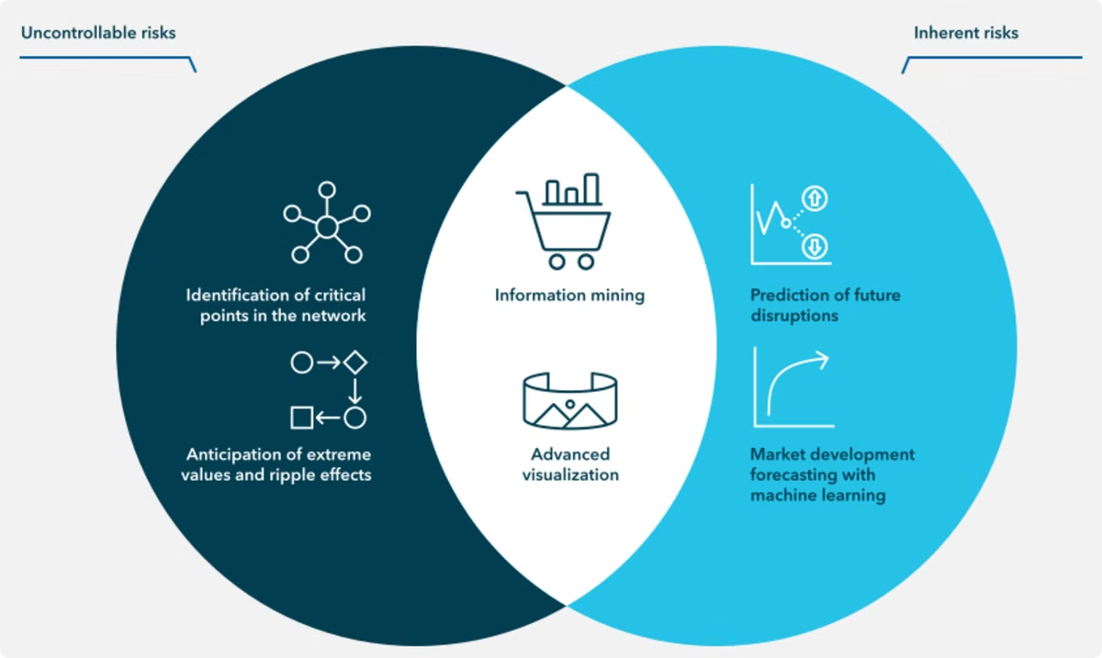
Quantum Simulations for Supply Chain Risk Management
Scenario Modeling
Predictive Analytics
Quantum simulations can model complex supply chain scenarios to anticipate and mitigate potential disruptions.
Quantum-powered predictive models can forecast demand, inventory levels, and other critical supply chain metrics.
Resilience Planning
Optimization Opportunities
Quantum computing enables the design of more robust and adaptable supply chain networks.
Quantum algorithms can identify optimal strategies to minimize risk and maximize efficiency.

Slide 6





Quantum Sensors for Asset Tracking and Inventory Management
Real-Time Visibility
Quantum sensors enable precise, real-time tracking of assets and inventory across the supply chain.
Optimized Stock Levels
Quantum-powered inventory management systems can accurately forecast demand and optimize stock levels.
Increased Efficiency
Quantum technologies streamline logistics operations, reducing waste and improving overall productivity.

Slide 7





Combining Quantum and Classical Computing for Hybrid Solutions
Data Preprocessing
Classical computing excels at handling large datasets, preparing them for quantum analysis.
Quantum Optimization
Quantum algorithms can solve complex optimization problems that are intractable for classical computers.
Hybrid Decision-Making
Combining quantum and classical insights enables more informed and agile logistics decision-making.

Slide 8


Overcoming Challenges in Implementing Quantum Technologies
1
Hardware Limitations
2
Software Integration
Ongoing development is needed to scale and stabilize quantum hardware for real-world logistics applications.
Seamless integration of quantum solutions with existing logistics systems and processes is crucial.
3
Talent Acquisition
Attracting and retaining skilled quantum computing professionals is a key challenge for logistics companies.

Slide 9


Case Studies: Successful Quantum Computing Applications in Logistics
Company
Application
Benefits
DHL
Quantum-Powered Vehicle Routing
20% reduction in transportation costs, 15% decrease in emissions
Maersk
Quantum Simulations for Supply Chain Risk Management
Improved visibility, faster response to disruptions, enhanced resilience
Amazon
Quantum Sensors for Inventory Optimization
99.9% inventory accuracy, reduced stockouts, and optimized storage space

Slide 10
The Road Ahead: Quantum Computing's Transformative Potential in Logistics
Quantum-Powered Decision Making
Enhanced Supply Chain Resilience
Sustainable Optimization
Quantum-driven logistics optimization will reduce emissions, waste, and environmental impact.
Quantum algorithms will enable logistics leaders to make more informed, data-driven decisions.
Quantum computing will help logistics networks anticipate and adapt to disruptions with agility.

